Slide 1
Evaluating the significance of outdoor advertising utilizing computer vision - ii
Carlos Andres Pizarroso Troncoso
Supervisor: RNDr. Zuzana Berger Haladová, PhD

Slide 2

Recap I: motivation
Impact of roadside advertisements on drivers’ attention.
Development of a system that contributes to road safety.
Application of Deep Learning technologies in Computer Vision.

Slide 3
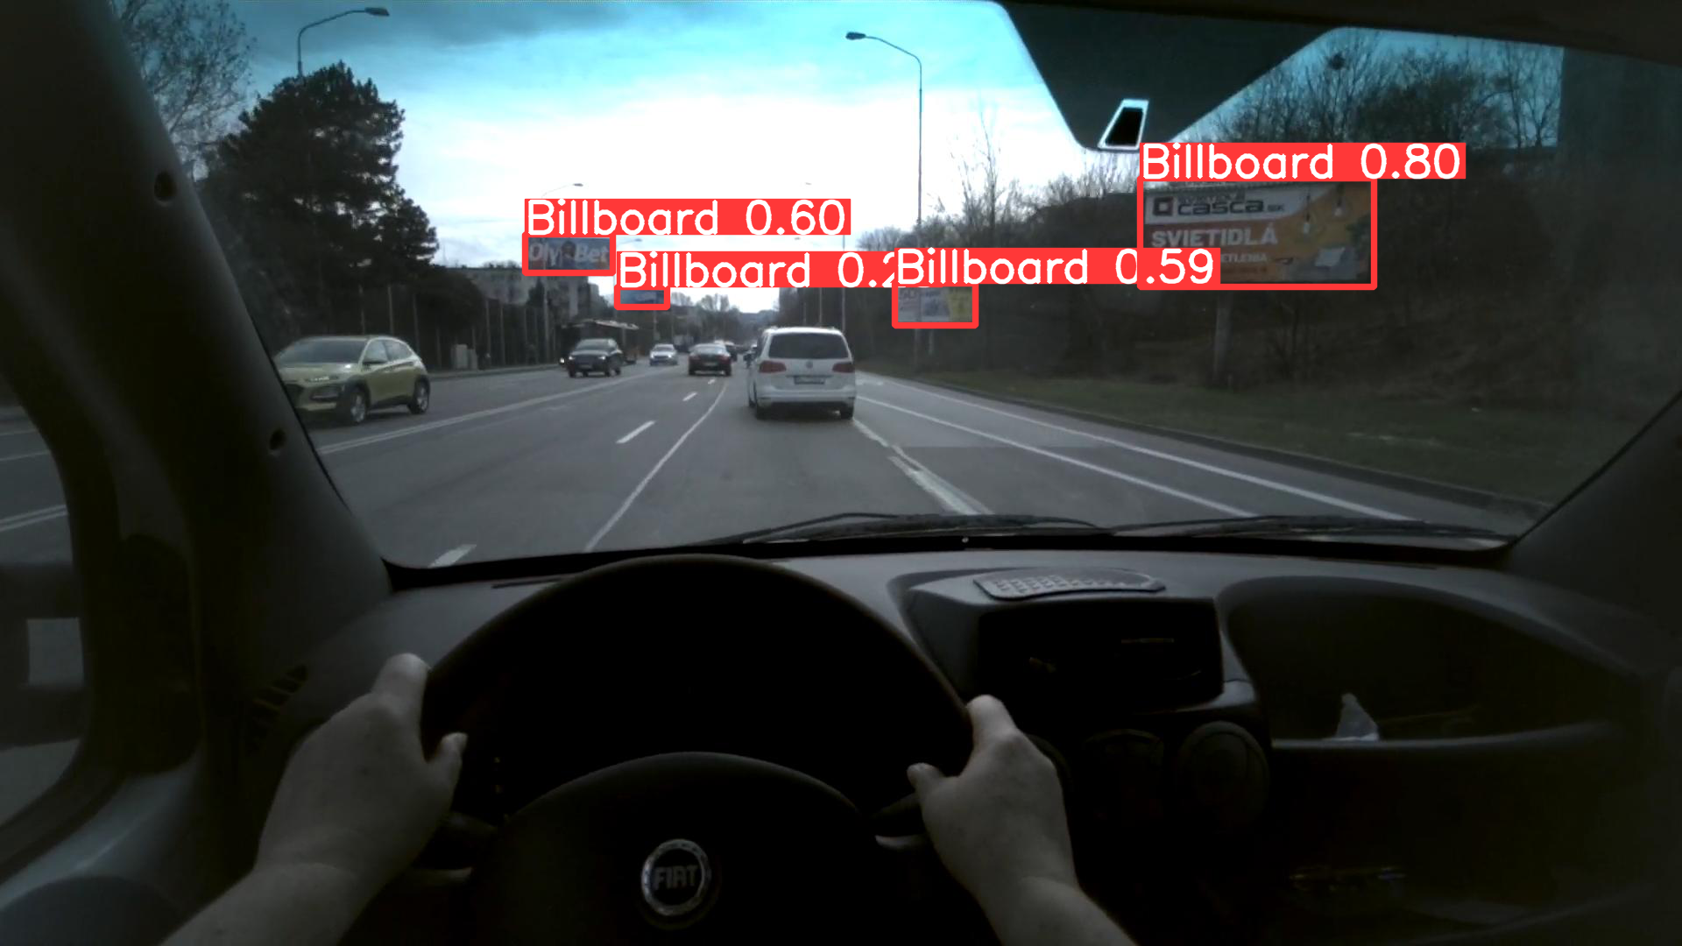
Recap ii: project objectives
To develop an automated system which evaluates road advertisement significance.
To train an object detector which is capable of accurately detecting roadside billboards.
To build a classification system which will be able to categorize drivers’ gaze on billboards.

Slide 4
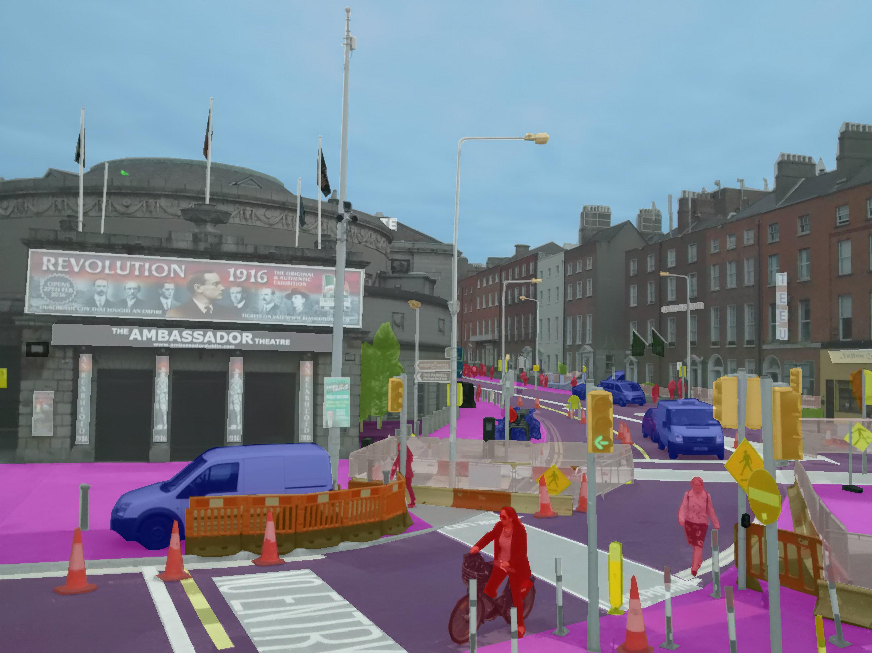
Recap iii: datasets for object detection
Mapillary Vistas Dataset
Large high resolution street object image dataset.
25000 images available -> 9700 images used for object detector training.
An increase from 3000 to 9700 images.
BillboardLamac Dataset
Smaller dataset focused on roadside billboards.
1213 high resolution images used for fine-tuning the object detector.

Slide 5
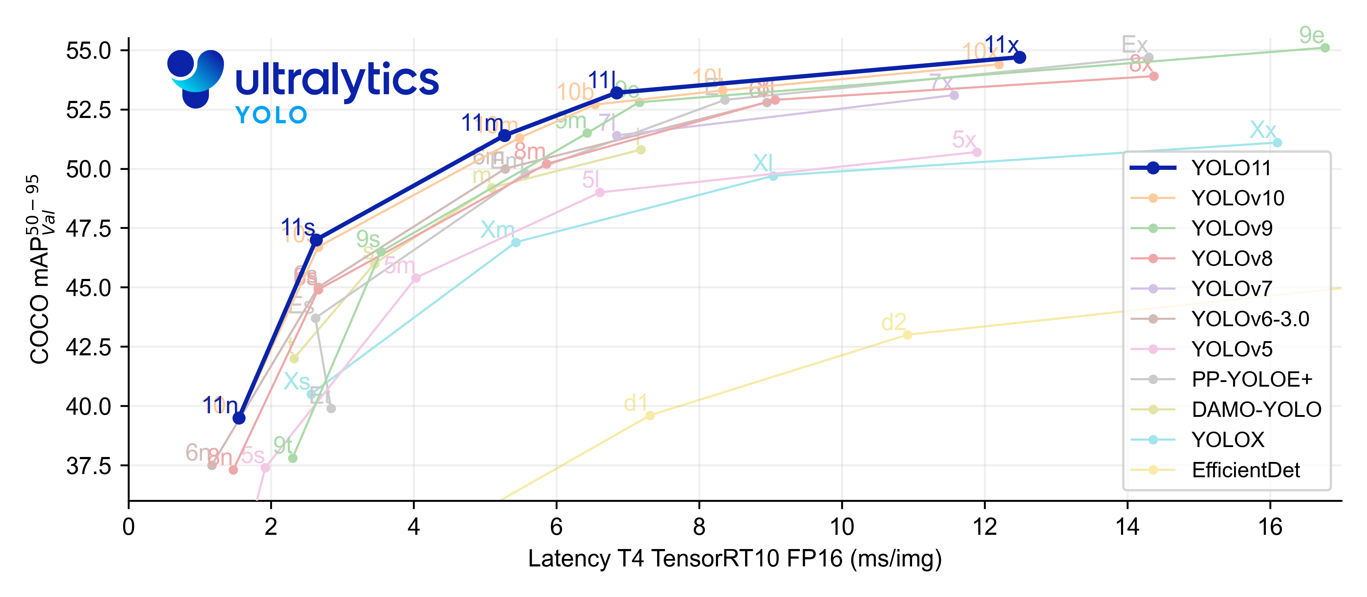
recap iv: pre-trained models
Object Detection Tasks:
Comparison between robust models (YOLOv8) and the newest versions (YOLO11).
Training methods: Merging datasets (Seminar 1) vs base training with Mapillary Vistas and fine-tuning with BillboardLamac dataset (Seminar II).
Classification Tasks:
Currently under development: Trying different training strategies with YOLO and RESNET classification pretrained models.

Slide 6

Resources i
Due to the limitations experienced previously, we stopped training in the cloud.
Instead, the training of all models were performed using the DAI GPU Computing Servers.
Due to its specifications, all trainings were done in Jupiter server.

Slide 7

Resources ii
Jupiter GPU Computer Server:
CPU: AMD Ryzen 9 7950X (16 cores, 32 threads, 4.5–5.7 GHz)
RAM: 64 GB
SDD: 4 TB
GPU: 2 × NVIDIA GeForce RTX 4080 Super, each with16 GB of memory
Due to its specifications, parallel training was possible!

Slide 8
Training process
Mapillary Vistas Subset Data
Base Training
Metrics Evaluation
Billboard-Lamac Dataset Fine Tuning
Metrics Evaluation
Pre-trained Model
Best Model Selection
Best Model Selection

Slide 9
Metrics Evaluation
Precision: Measures how accurate the detector is when it identifies a billboard.
High precision means fewer false detections.
Recall: Measures the detector's ability to find all billboards.
High recall means fewer missed detections.
mAP@50: The average precision across all classes for detections with at least 50% overlap with the ground truth.
mAP@50-95: Average precision across IoU thresholds ranging from 50% to 95%, calculated in steps of 5%.
Fitness: A composite score balancing Precision, Recall, and mAP to represent overall model performance.

Slide 10
Object detector training i: base training
Training the object detector by using a pre-trained YOLOv8 model first on a subset of Mapillary Vistas Dataset.
A total of 28 trainings trying different hyperparameters.
Additional 2 trainings using the latest YOLO model (11 series) using the best set of hyperparameters found earlier.
2 best models selected, 1 per YOLO version.
Metric | 19th Training (YOLOv8) | 27th Training (YOLO11)
Precision | 0.454 | 0.510
Recall | 0.508 | 0.480
mAP@50 | 0.455 | 0.467
mAP@50-95 | 0.323 | 0.334
Fitness | 0.337 | 0.347

Slide 11
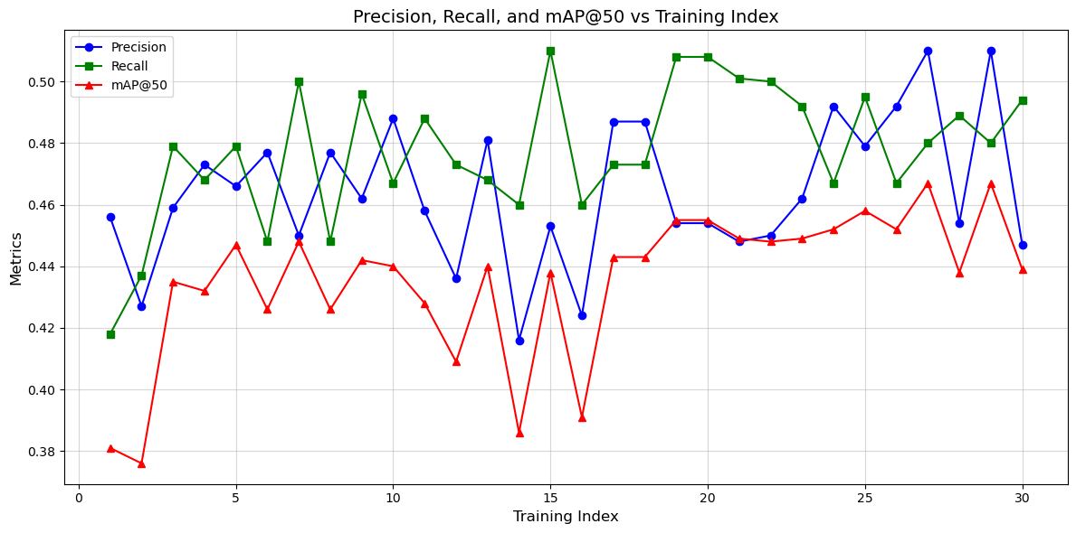
Object Detector training I: results

Slide 12
Object detector training i: Best models’ hyperparameters
Base Training YOLOv8 Model (19th)
Base Training YOLO11 Model (27th)
Image size: 1280x1280
Batch size: 4
Epochs: 100
Pre-trained YOLO model: YOLOv8l (Large)
Data Augmentation: flipud (0.5), fliplr (0.5), scale (0.5)
Optimizer: Stochastic Gradient Descent (SGD)
Early Stopping: Yes
Training Time: 8 hours 40 minutes
Image size: 1280x1280
Batch size: 6
Epochs: 150
Pre-trained YOLO model: YOLO11l (Large)
Data Augmentation: flipud (0.5), fliplr (0.5), scale (0.5)
Optimizer: Stochastic Gradient Descent (SGD)
Early Stopping: Yes
Training Time: 13 hours

Slide 13
Object detector training ii: fine-tuning
The best models were fine-tuned using BillboardLamac dataset exclusively.
A total of 20 trainings performed, 10 per each model.
Similarly, different combination of hyperparameters tested.
Best two models selected.
Metric | 3rd Training (YOLOv8) | 10th Training (YOLO11)
Precision | 0.892 | 0.898
Recall | 0.884 | 0.919
mAP@50 | 0.931 | 0.940
mAP@50-95 | 0.770 | 0.794
Fitness | 0.786 | 0.809

Slide 14
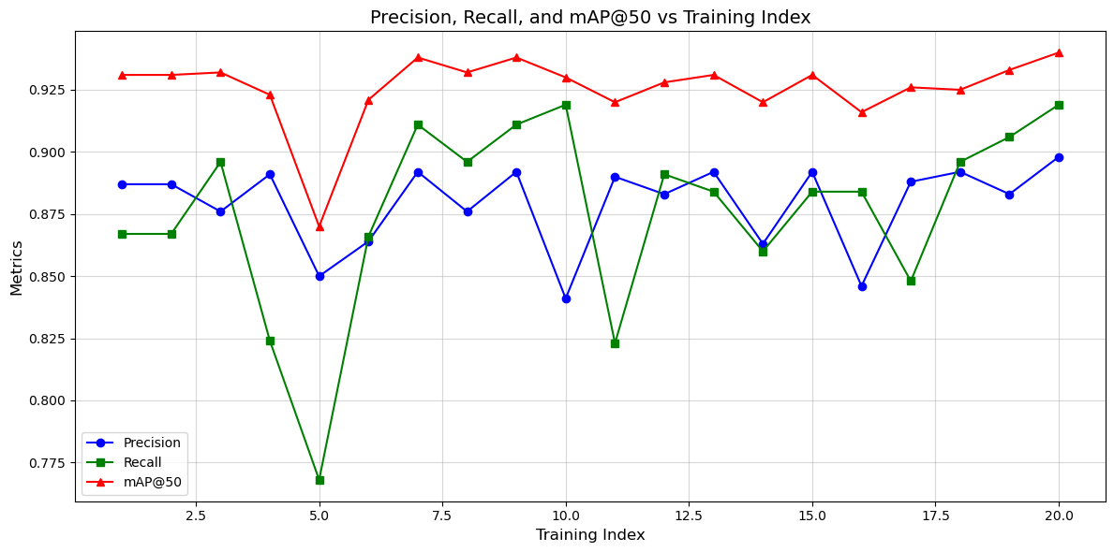

Slide 15
Object detector training ii: best fine-tunedmodels’ hyperparameters
Fine-Tuning YOLOv8-based Model (3rd)
Fine-Tuning YOLO11-based Model (10th)
Image Size: 1280x1280
Epochs: 100
Batch Size: 4
Rest of hyperparameters remained untouched (default)
Training time: 1 hour 2 minutes
Image Size: 1280x1280
Epochs: 500 (Early Stopped Activated at 396 epochs)
Batch Size: 6
Rest of hyperparameters remained untouched (default)
Training time: 4 hours 25 minutes

Slide 16
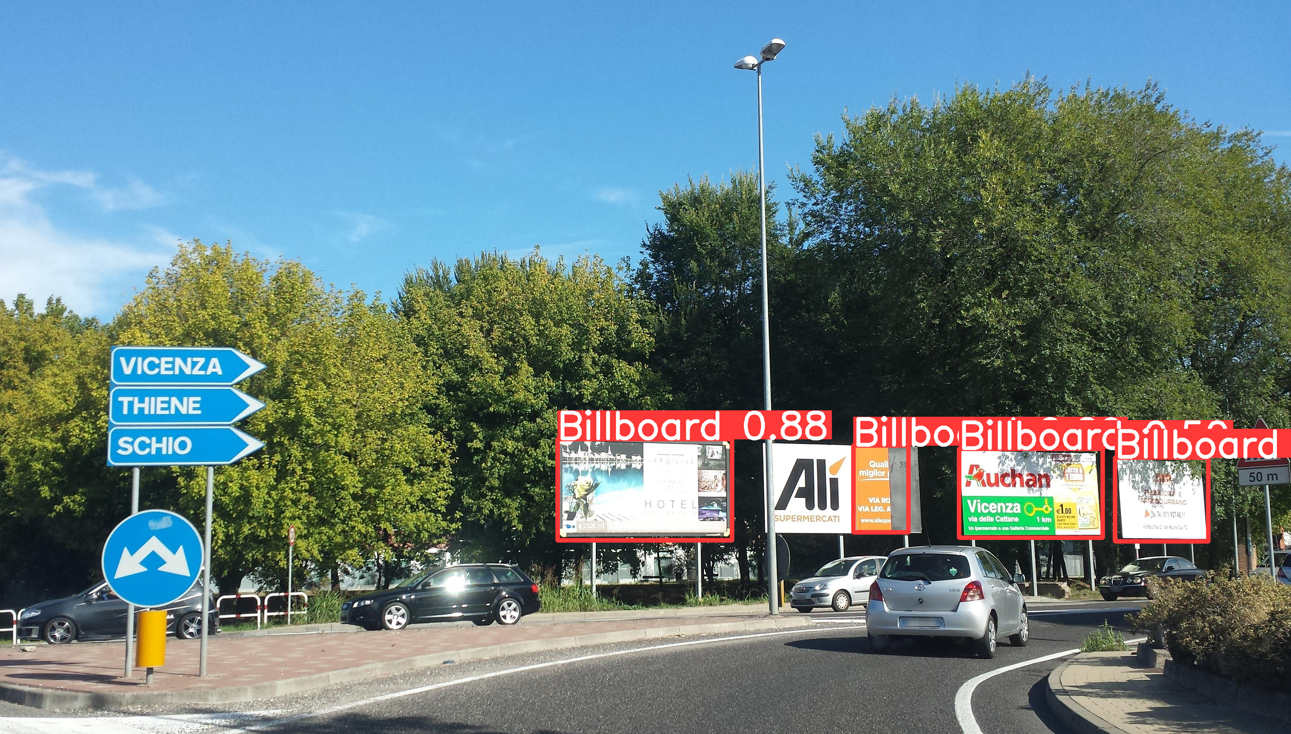
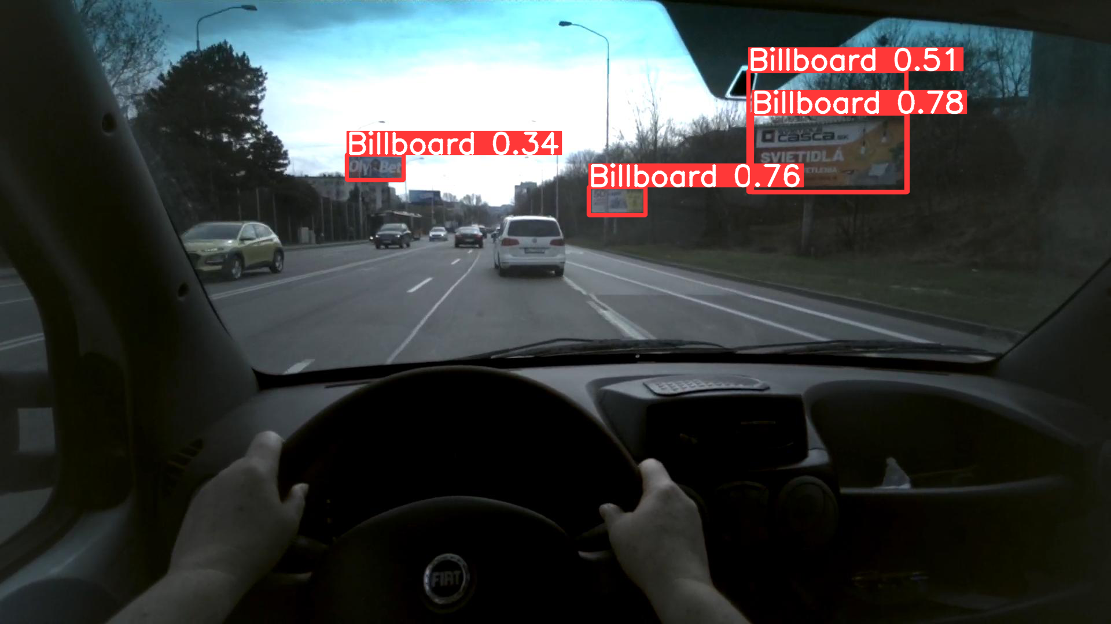
Results i: recap of the best model from previous semester
Testing on Mapillary Vistas Images
Testing on BillboardLamac Dataset Images

Slide 17
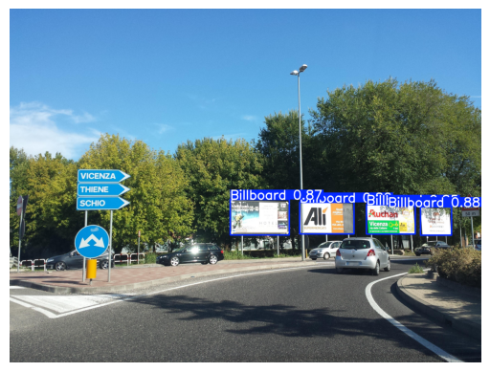
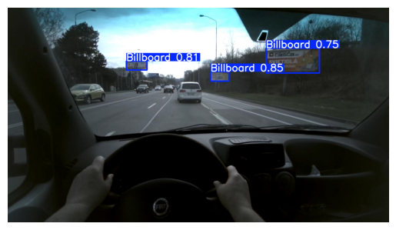
Results: testing yolov8 base model (without fine-tuning)
Testing on Mapillary Vistas Images
Testing on BillboardLamac Dataset Images

Slide 18

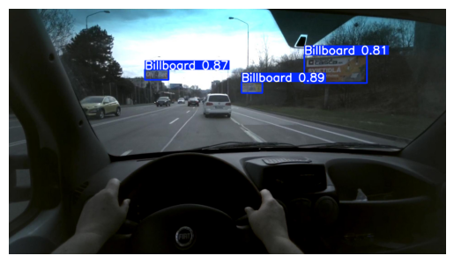
Results: testing yolo11 base model (without fine-tuning)
Testing on Mapillary Vistas Images
Testing on BillboardLamac Dataset Images

Slide 19
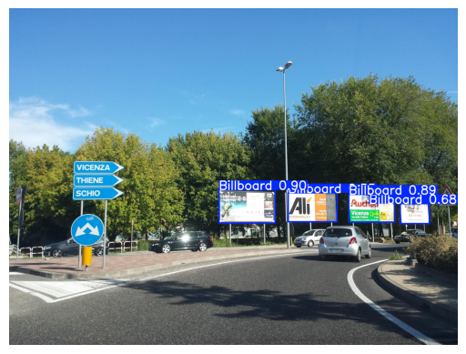
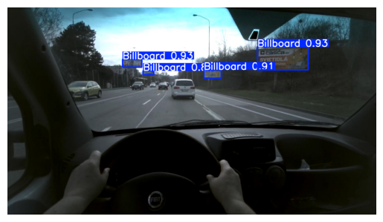
Results: testing fine-tuned yolov8-based model
Testing on Mapillary Vistas Images
Testing on BillboardLamac Dataset Images

Slide 20


Results: testing fine-tuned yolo11-based model
Testing on Mapillary Vistas Images
Testing on BillboardLamac Dataset Images

Slide 21
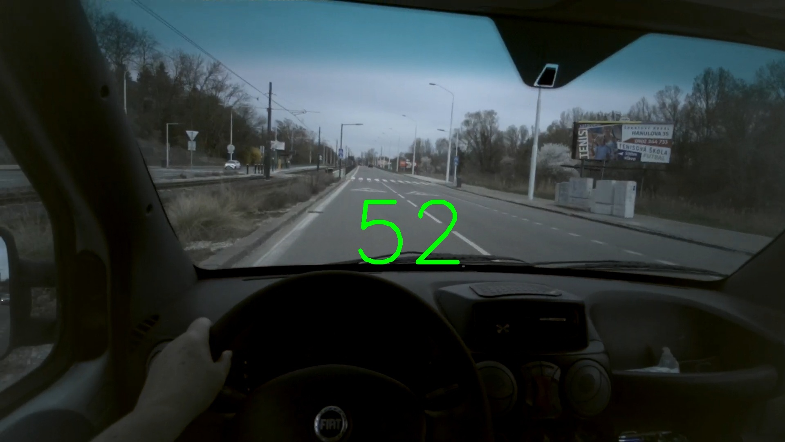
classification system development
BillboardLamac dataset includes a subset for the classification task.
Data is divided into 4 predefined gaze duration classes: long, medium, none, and short.
Each class has a set of images with IDs which link to additional information about billboards:
Billboard location in the image, size of the billboard, image in the billboard.

Slide 22


Further steps
Object Detection Task:
Review the best models.
Avoid overfitting.
Classification Task:
Try different strategies to get the best information possible from billboards.
Train the classification models using YOLO and RESNET pretrained models, comparing them.

Slide 23
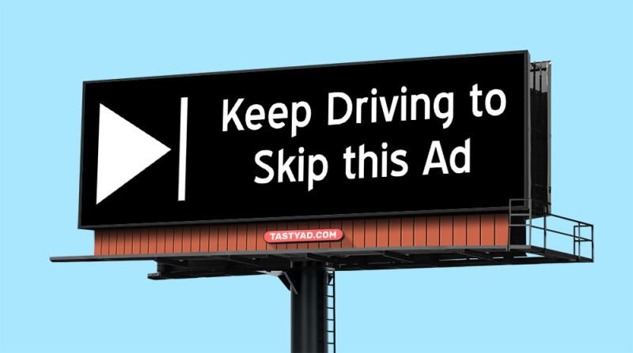
THANK YOU VERY MUCH FOR YOUR ATTENTION

